Slide 1
An Assessment of Flywheel Energy Storage in Islanded Operation for Residential Premises in Developing Countries
Academic Diaspora Conference
Mustafa E. Amiryar, PhD, AFHEA
1st September, 2019

Slide 2
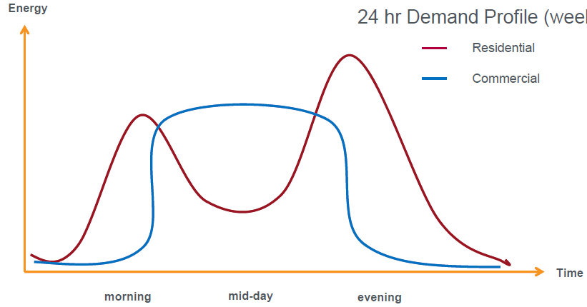
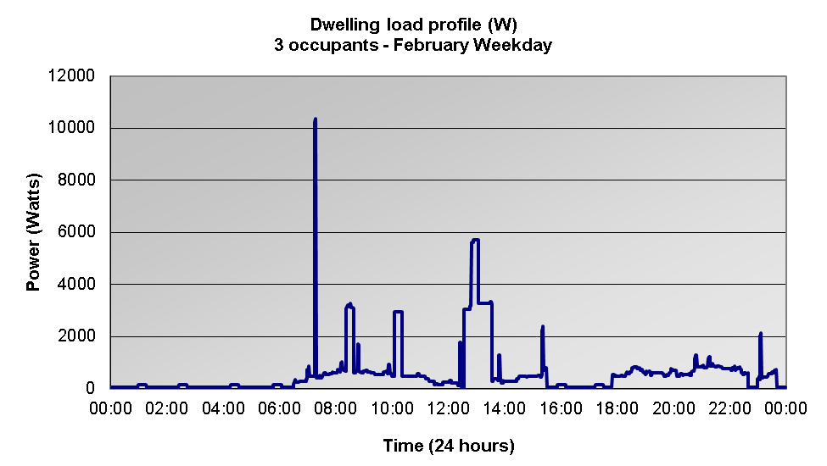
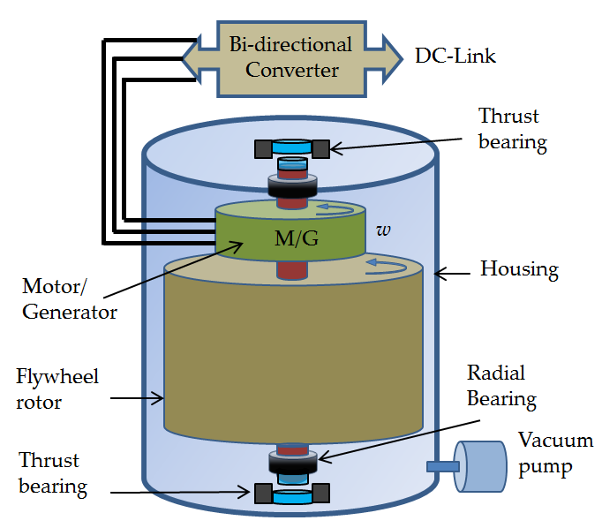
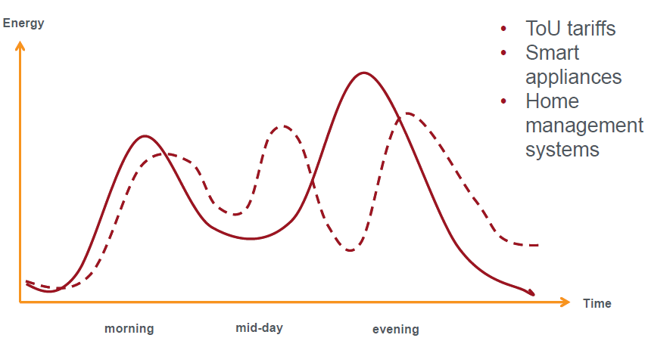
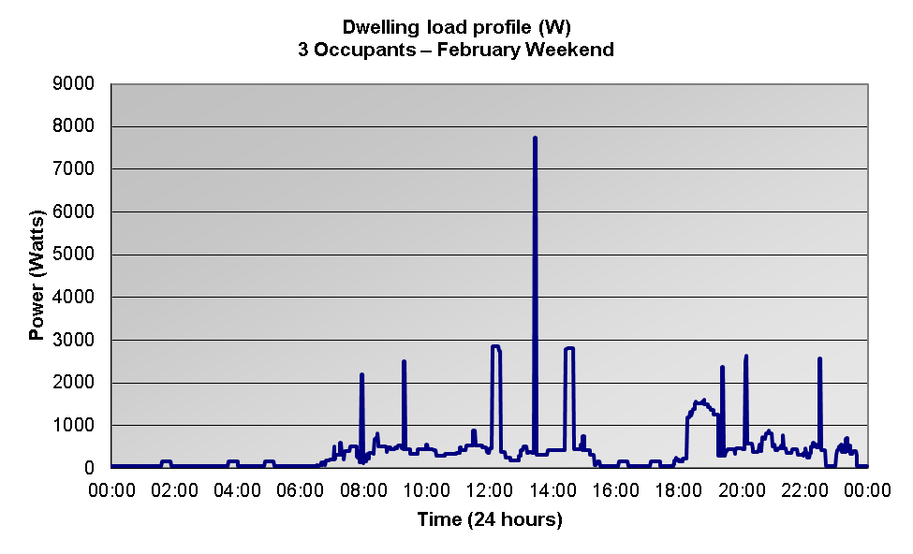
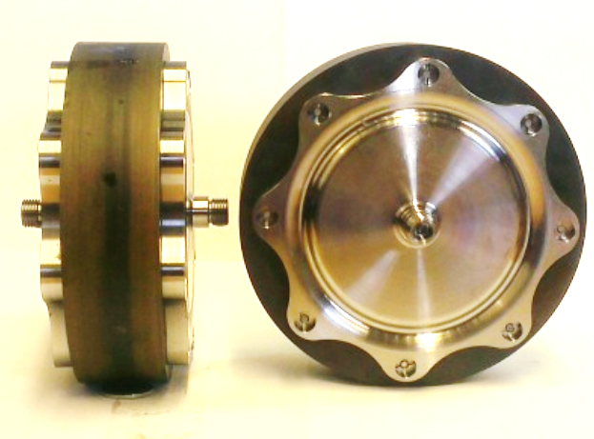
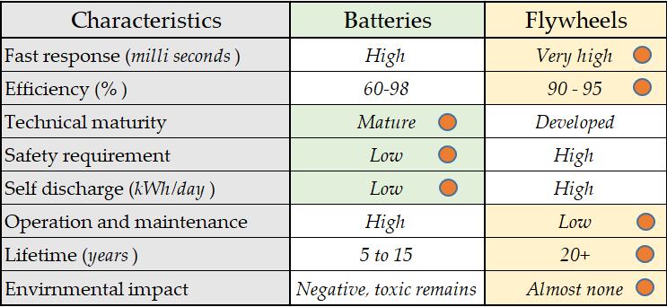
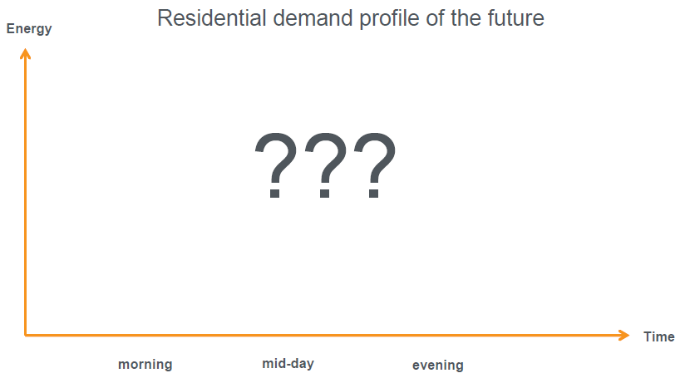
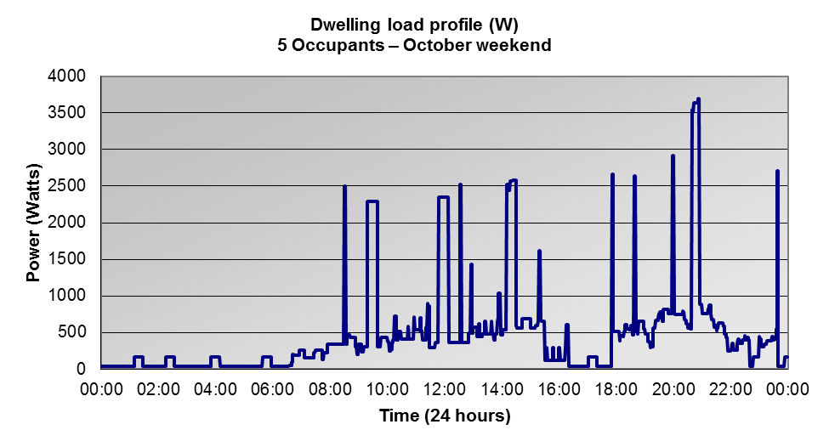
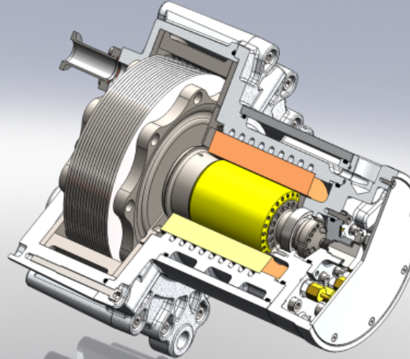
An Assessment of Flywheel Energy Storage in Islanded Operation for Residential Premises in Developing Countries
Need for Energy Storage - Background
FLYWHEEL Energy Storage
(Electromechanical battery):
A rotating mass about an axis that stores energy in the form of kinetic energy
An alternative energy storage technology to chemical batteries
Larger scale – Energy supplier level
Smaller scale – Residential level
Energy demand - Typical
Energy demand – New Paradigm
The Optimal Energy Storage
Energy demand – Future
ToU tariffs
Smart appliances
Home management system
Energy education
Mustafa Edries Amiryar, PhD

Slide 3
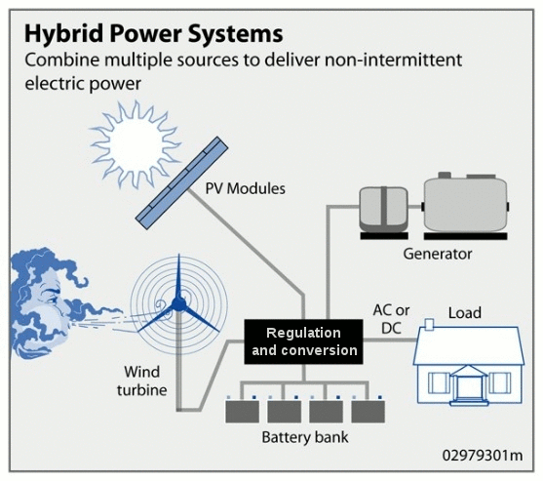
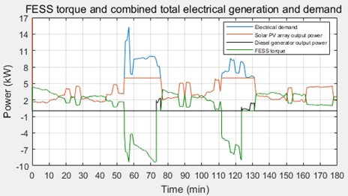
Objective:
Intermittent/unreliable electrical grid
Intermittent renewable energy sources
Dependency on inefficient diesel generators – sources of CO₂ emissions
Chemical batteries – The only established choice of storage in developing countries
Research findings:
The impact of flywheel evaluated under three different conditions (Profile 1, 2, and 3)
Use of diesel generator was reduced by 100%, 50% and 64%, respectively
Annual fuel cost savings of approximately £1350, £1460, and £1550, respectively
Minimum CO₂ emissions reduction was 0.915 MT CO₂ –eq
Maximum CO₂ emissions reduction was 3.2 MT CO₂ –eq
Flywheel completes 73000 cycles in 20 years (average 10 cycles per day) based on analysis
For a Li-Ion battery to complete these cycles, must be replaced more than 5 times in 20 years for 50% DoD, and 12 times in 20 years for 80% DoD.
Lead-Acid batteries will be replaced 28 times in 20 years for 50% DoD while Sodium-Sulfur type will be replaced 12 times in 20 years for 50% DoD.
Mustafa Edries Amiryar, PhD

Slide 4
Thank you for listening
Questions ?

Slide 5
https://www.youtube.com/watch?v=A4c_7h3IpRY https://www.youtube.com/watch?v=r5ee1l8thvs https://www.youtube.com/watch?v=u6I2lKtfpLQ https://www.youtube.com/watch?v=5suX03dhK2I
How a Flywheel works - Vidoes

Slide 6
References:
M. E. Amiryar and K. R. Pullen, “A review of Flywheel Energy Storage System Technologies and Their Applications,” Applied Sciences, MDPI, vol. 7, no. 3, pp. 286-307, 2017.
M. E. Amiryar, K. R. Pullen, D. Nankoo, “Development of a High-Fidelity Model for an Electrically Driven Energy Storage Flywheel Suitable for Small Scale Residential Applications,” Journal of Applied Sciences, MDPI, vol. 8, no. 3, pp. 453-482, 2018.
A. Soomro, M. Amiryar E, P. Keith R and D. Nankoo, "Comparison of performance and controlling schemes of synchronous and induction machines used in flywheel enregy storage systems," Energy Procedia, vol. 151, pp. 100-110, 2018.
Chen, H., Cong, T. N., Yang, W., Tan, C., Li, Y., & Ding, Y. (2009). Progress in electrical energy storage system: A critical review. Progress in Natural Science, 19(3), 291–312. doi:10.1016/j.pnsc.2008.07.014
Hadjipaschalis, I., Poullikkas, A., & Efthimiou, V. (2009). Overview of current and future energy storage technologies for electric power applications. Renewable and Sustainable Energy Reviews, 13(6-7), 1513–1522. doi:10.1016/j.rser.2008.09.028
Crespo Del Granado, P., Wallace, S. W., & Pang, Z. (2014). The value of electricity storage in domestic homes: a smart grid perspective. Energy Systems, 5(2), 211–232. doi: 10.1007/s12667-013-0108-y
S., Sebastián, R., Quesada, J., & Colmenar, A. (2011). Review of Flywheel based Energy Storage Systems. Proceedings of the 2011 International Conference on Power Engineering, Energy and Electrical Drives. (May).

