Slide 1

Placental structural and functional adaptation to a diabetic environment
Seley Gharanei, PhD, AFHEA
01-09-2019

Slide 2
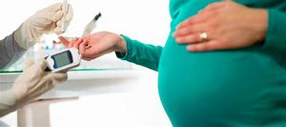
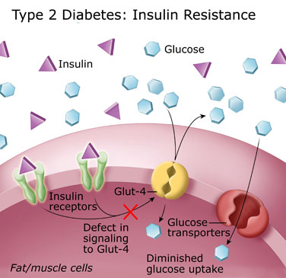
Diabetes Mellitus
Gestational Diabetes Mellitus (GDM)
Type 1
Type 2
Autoimmune disease
Common (IDF - 371 million)
2030 - 550 million
50% of woman with GDM will develop diabetes over a period of 5 to 20 years time.
GDM is associated with maternal/foetal complications: birth trauma, respiratory distress syndrome, intrauterine growth restriction, preeclampsia, macrosomia and neonatal hypoglycaemia.
Neonates born to GDM pregnancies - developing diabetes, hypertension and other metabolic disorders later in life
Universal screening for GDM: at 24-28 W
Notes:
Diabetes mellitus is a chronic metabolic disorder due to either insulin deficiency or due to peripheral tissue resistance(decrease sensitivity) to the action of insulin.
The pathophysiology involved are:
Insulin resistance
Inadequate secretion of insulin (Beta cell dysfunction)
Diabetes mellitus first recognised during pregnancy
GDM affects up to 18% of the pregnancy worldwide
Prevalence is increased by 64% in the past 2 decades due to continues rise in obesity

Slide 3
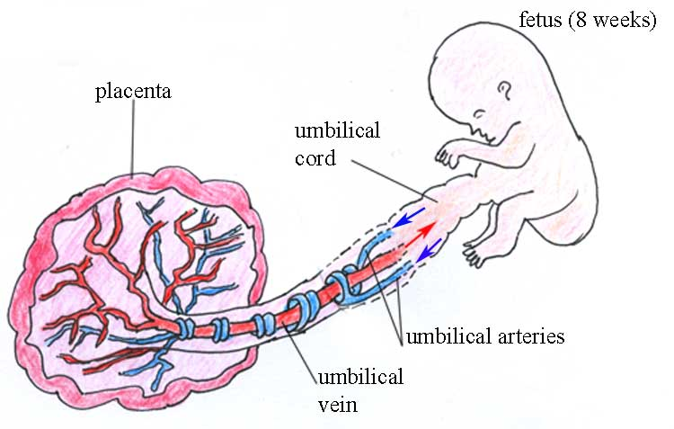
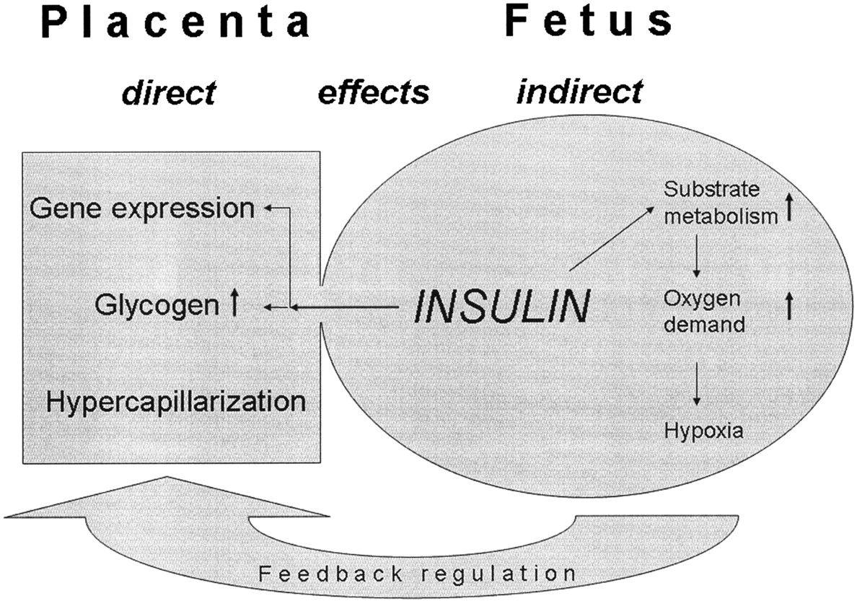
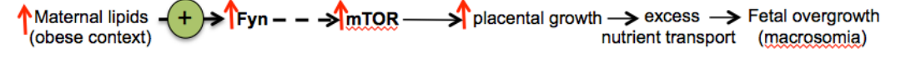
GDM associated changes to the placenta
Macrosomia
Birthweight>4kg
Complications at delivery
Increased risk
Separates maternal and foetal circulation
Affected by any changes in both circulation
Sensitive to the diabetic environment and responses with adaptive alterations of the structure and function
WFS1
V1a
(Desoye.,2007)
PDI
WFS1
PDI

